Slide 1
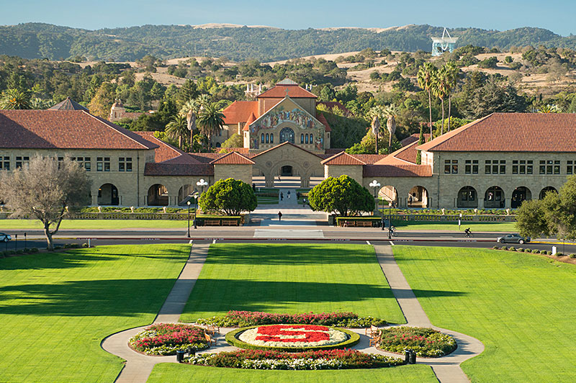
Welcome to Computer Science at Stanford University!

Slide 2
Reminders:
Pick up keys for Gates building at Room B18.
If you have not taken a picture yet, please come to Room 196 by the end of the day.

Slide 3
Overview of Academic Requirements for the PhD
Year
One: • CS 300
• Rotation program, choosing a permanent research advisor
Two: • Completing Breadth requirements
• 3 units of coursework from at least 4 different faculty members
• Filing for Candidacy
Three: • Quals
• Teaching requirement
Four: • Reading committee Form and thesis proposal
Five, Six: • Complete 135 units
• Orals
• Dissertation

Slide 4
PhD Academic Requirements
https://cs.stanford.edu/academics/phd/phd-requirements/academic-requirements
https://cs.stanford.edu/academics/phd/graduate-student-forms

Slide 5
Department requirements
Everyone is required to be enrolled in 10 units.
First quarter – 1 unit of CS 300 and at least 3 units of CS 499 with faculty (or research equivalent of CS 499 for students rotating with faculty outside of CS department).
Minimum enrollment is 8 units. Total units should not exceed 10 units in each quarter.
University requirement of GPA 3.0 to graduate.

Slide 6
Financial Support
Everyone gets the same level of support.
Sources of support
- Research Assistantship
- Fellowship – external/internal
- Course Assistantship

Slide 7
Important Dates
Sept 25 First day of Autumn Quarter; instruction begins
Sept 25 Preliminary Study List deadline
(Must be enrolled in at least 8 units to avoid late fee)
Oct 13 Final Study List deadline
(All course enrollment, units, grading basis must be finalized)
Oct 29 Axess opens for Winter Quarter course enrollment
*Please review your academic calendar for more!
http://exploredegrees.stanford.edu/academiccalendar

