Slide 1
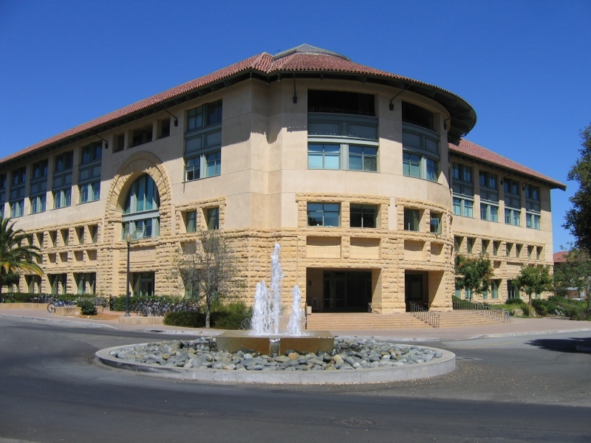
New CA Training
Stanford Computer Science Department
Fall 2016 – 2017
David Hyde and Jason Riggs
CS Department CA Mentors
Notes:
introduce yourself!
i will have them introduce themselves when they ask questions
Raise your hands:
Masters/PhD students
first time TAs
TAing for your advisor? TAing a class that you have taken?
more fun if people ask questions

Slide 2
agenda
University policies
Your duties as a Course Assistant
Effective teaching
Additional resources
Your questions

Slide 3
university policies
University Policies
The honor code
Students with disabilities
Sexual harassment

Slide 4
https://oae.stanford.edu/video-resource-teaching-assistants
Notes:
This video puts you right into some serious issues like sexism, sexual harassment, cultural issues
I want you to watch the video and have a chance to eat, think about your role as a TA
making people feel welcome, safe, to learn
---
Reactions?

Slide 5
honor code
Agreed to by every student and faculty member
https://communitystandards.stanford.edu/
Notes:
How many Stanford undergrads here?
What does honor code mean to you?

Slide 6
honor code
It is your responsibility not to put students in a position to violate the Honor Code
Reduce the temptation to cheat:
Clearly state permitted types of aid and collaboration
Don’t reuse old assignments
Provide plenty of practice material
Set intermediate milestones for large projects
Honor Code violations do happen!
If you suspect a violation, talk to the professor
The Honor Code prohibits penalty grading
Notes:
you may consider putting people who work together under the same TA for grading
big exam rooms
note cards/cheat sheets?
if you have doubts, say them! it’s okay to be wrong.

Slide 7
honor code
Agreed to by every student and faculty member
https://communitystandards.stanford.edu/
Computer Science Honor Code
http://csmajor.stanford.edu/HonorCode.shtml
http://stanfordvideo.stanford.edu/stream/oja/hc-computer_science.html

Slide 8
cs dept honor code
“In computer science courses, it is usually appropriate to ask
others... for hints and debugging help or to talk generally
about problem-solving strategies and program structure.
In fact, students are strongly encouraged to
seek such assistance when needing it.”
Notes:
what is special for CS?
root of the issue:
What is plagiarism in CS?

Slide 9
cs dept honor code
Guidelines for students:
Indicate on your submission any assistance you received
Never share actual code with others
Do not look at solutions/code from previous years
Be prepared to explain any program code you submit
Notes:
CS honor code provides instructors and students with the following guidelines

Slide 10
students with disabilities
Student must initiate request for special aid with the Office of Accessible Education (not the CA)
http://studentaffairs.stanford.edu/oae
Typically, students receive extra time on exams or take them in a different setting
Things you can do to help:
Read what is written on the board as you write it
Face and speak to the class, not the board
Handouts in electronic format are easier to read

Slide 11
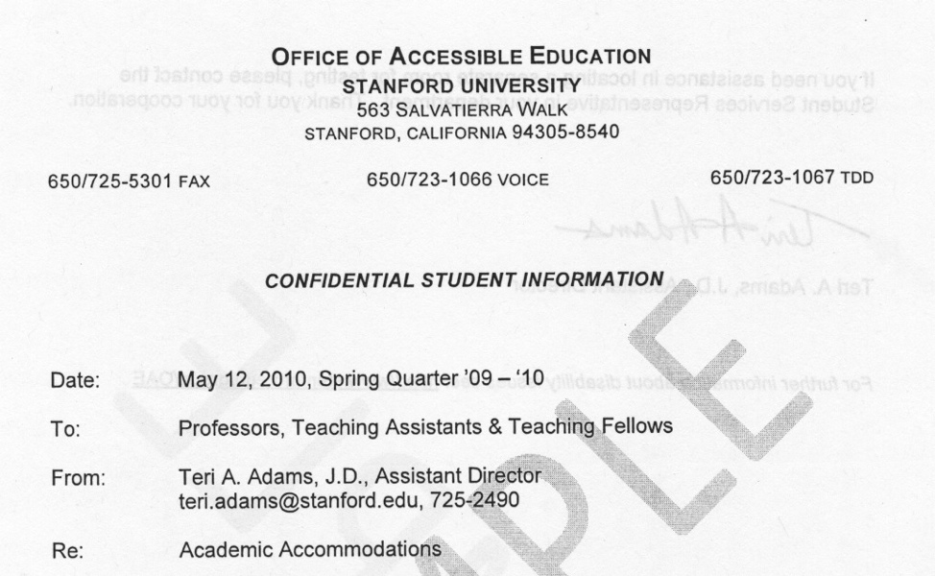
oae sample letter

Slide 12
sexual harassment
Unwelcome sexual advances, inappropriate jokes, ...
or physical conduct of a sexual nature when:
Implicit or explicit suggestion that submission to or rejection of conduct will factor into academic evaluation
Conduct interferes with individual’s academic environment
http://harass.stanford.edu
Notes:
If you are open, easy to talk to, ... you may hear about this kind of stuff.
Report it! Come to me if something happens. Think about it right now - who to talk to.

Slide 13
sexual harassment
In relationships between individuals in inherently unequal positions (teacher-student, coach-athlete, etc.), the person in the position of greater power bears the primary burden of accountability.
This person is required to notify their supervisor so that alternative evaluative arrangements can be made if needed.
Failure to do so is a violation of the policy
http://harass.stanford.edu
Notes:
If you are open, easy to talk to, ... you may hear about this kind of stuff.
Report it! Come to me if something happens. Think about it right now - who to talk to.
The quarter system is short, homies!

Slide 14
thought experiments
Imagine yourself in the same situation as Karen. How would you respond if a student made an inappropriate comment towards you?
After giving a midterm, you receive an email from a student, who says the people in front of her were whispering during the exam.
A student requests an extension because of a learning disability.
What if the student had had a bicycle accident? Family emergency?

Slide 15
agenda
University policies
Your duties as a Course Assistant
Effective teaching
Additional resources
Your questions

Slide 16
course assistant duties
Course communication and administration
Homework, exams, solution sets
Grading and grade tracking
Office hours, sections, reviews
A historical note:
CA = Course Assistant, TA = Teaching Assistant
Same commitment and compensation, but assistants who will teach new material are designated TAs

Slide 17
time commitment
25% CA
10 hours/week, 2 hours of office hours
50% CA
20 hours/week, 4 hours of office hours
May only register for 10 units of courses
Time commitment is an average
You will work more during some weeks, less during others

Slide 18
starting the quarter
Meet with the professor!
Establish goals, duties, and expectations
Set up course communication means
Ideally by first day of the quarter
Course web page
Mailing lists and newsgroups
Notes:
people teaching larger classes?
especially for larger classes, you may want to set up a weekly “administrative meeting” with the whole course staff. more efficient then emailing about everything.

Slide 19
course information
Prepare & deliver course info on the first day of class:
Meeting times and location
Teaching staff: office location/hours, contact info
Course description, prerequisites, textbooks
Late policy, collaboration policy, grading policy
Schedule of exams, major projects, assignments
Notes:
some of you may have already had your first day of class

Slide 20
communication with students
Many different flavors
Web page, class email lists, newsgroup, Piazza, in-class announcements...
Method not as important as establishing a consistent means of communication
Professor may already have a preferred method
Someone must maintain it
Notes:
Mention Canvas - new system.

Slide 21
setting up communications
Old skool (http://courses.stanford.edu)
web site, email list, disk space, newsgroup
CourseWork (http://coursework.stanford.edu) and CourseWare (http://courseware.stanford.edu)
New skool: Canvas (https://canvas.stanford.edu)

Slide 22
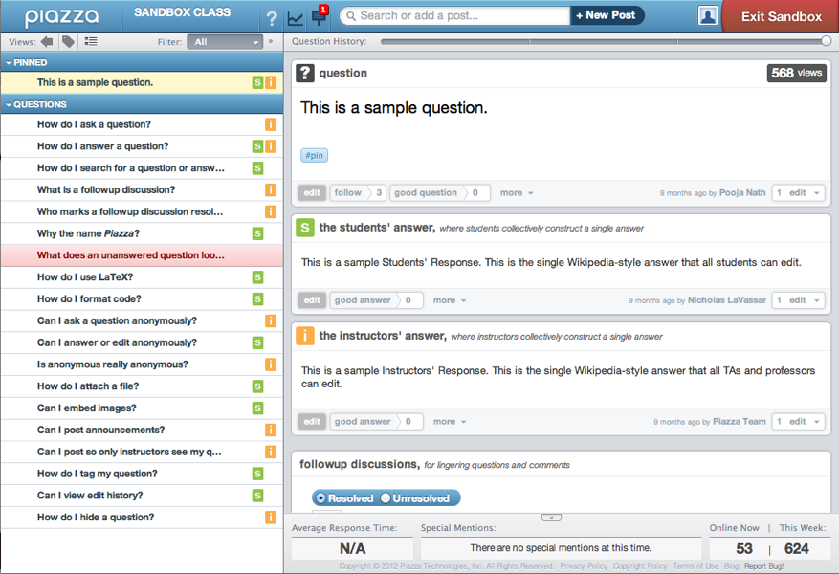
piazza - online q&a
http://www.piazza.com

Slide 23
email communication
Students will email you... a lot!
Respond in a timely manner, but:
Manage the load
Divide responsibility among course staff
Set expectations for turnaround time
Suggest use of office hours, especially if the questions are difficult to answer via email
Compile and make available answers to FAQs
Notes:
biggest unknown time sink in my experience
grading, prepping, .... all have reasonable work-in/effect-out
schedule yourself! make sure it doesn’t eat into your research/school time.
you take the email load one day per week?
---- THOUGHT EXPERIMENT
You know someone in the class personally. They keep emailing your personal email address/stopping by your office...

Slide 24
grading
Should be done in a timely manner
Return graded assignment before the next one is due
Pick a weekly time when CAs grade together
Or, take turns grading week to week.
Should be consistent and fair
Agree on grading criteria beforehand
The same person grades a question across all students
Read through a few solutions before starting
Notes:
Let’s talk about grading... one of your big duties
So important! Don’t do something for one student you wouldn’t do for another. It is best for everyone.
Thought Experiment: what if you are friends with someone in your class? [idea: grade sets starting with them upside-down so you can’t see the name.]

Slide 25
grading
Rubrics help enormously.
Increase fairness, efficiency; requires some “preprocessing” but is totally worth it.
Point distribution
Prefer 0, +1, +2 over 75.25, 75.5, etc.
Provide solution sets
List common mistakes, point distributions.
Some professors may be hesitant to post solutions.
Notes:
Rubrics are the flossing of teaching. Everyone knows they’re really good but they can seem like sort of a drag.
A little risky: the more control you have over the problem sets, the more you can influence the grading rubrics/policy.

Slide 26
re-grading
How should I handle re-grading requests?
Permissive – Point-monger paradise, CA nightmare
Risky Game – Reserve the right to re-grade everything
Bureaucratic Nightmare – Require written justification
Lazy Evaluation – Defer until the end of the term; regrade if the points affect the student’s final grade.
Do not re-grade with the student present!
Listen to their explanation, then ask them to leave the graded work with you
Notes:
deferring grading can keep them calm!

Slide 27
grade tracking
Spreadsheet (Excel, Calc, Numbers...)
Google docs spreadsheet
Facilitates multi-user editing and collaboration, versioning
But: privacy!
CourseWork
... other tools available.

Slide 28
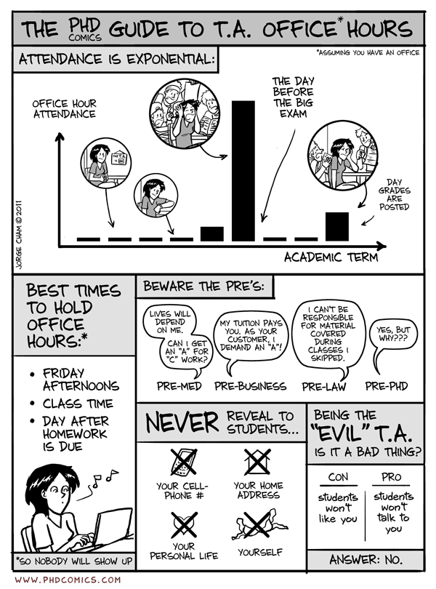
Notes:
make friends with the other TAs so you have backup in case of an emergency!

Slide 29
office hours
Inform students of times and locations
Use course web page and mailing lists
Ideally by second week of class
Office hour times - when should I hold them?
Your convenience?
Students’ convenience?
Adjust hours according to students’ needs
Be on time and don’t cancel at the last minute
Announce any changes through course communication
Notes:
make friends with the other TAs so you have backup in case of an emergency!

Slide 30
office hours
Office hour locations - where should I hold them?
Your own office is OK, provided it is accessible
Gates B24 and B26 - two cubicles per room
Managed on Google calendar, Meredith will ask for a Gmail address
Visit Gates 176 to get your Gates building key reprogrammed, or to get a key if you need one
Exterior doors are locked after 5:30pm and on weekends – remind students to carry their Stanford ID card
Library or computer clusters (Gates B08, B30)
Other? Bytes, Coupa, Skype, ...

Slide 31
office hours
Notes:
You’ve all been students before. What are some things that make for good OH?

Slide 32
office hours
Preparation is key!
Attend lectures to keep up with what’s going on
Read the assignments and understand the solutions
Prepare hints or milestones for completing assignments
Encourage attendance
e.g. write a note on a struggling student’s problem set
Be reassuring and patient
Be open to suggestions and feedback
Notes:
In my experience, students can tell what is going well in a class and what isn’t. They may tell you things they might not mention to the prof.
Keep your ears open.
Thought experiment: What to do if people pile up in your office hour?

Slide 33
prof-ca relationship
Meet and talk often
Open, honest, and respectful dialogue makes life easier
Discuss who is doing what and when
Never assume something unassigned will get done
Seek and communicate student feedback
Students tend to be more candid with their CAs
Solicit feedback early to help improve the course
Communicate student feedback tactfully (i.e., professors are people too.)

Slide 34
evaluations
CAs receive no official department evaluation
Ask for feedback and suggestions
In office hours or through a feedback form
Ask fellow CAs to attend your section and give feedback
VPTL evaluations
Small group evaluations
Online mid-quarter evaluations
DVD recording and one-on-one coaching
https://teachingcommons.stanford.edu/teaching-services

Slide 35
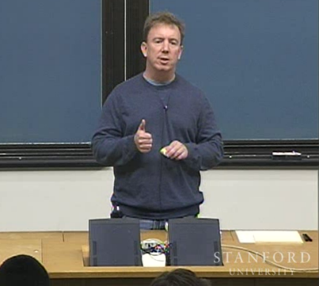
SCPD Courses
Dress appropriately for video-taped sections
Give a contact phone number during office hours
Prefer an office number over a personal cell number
Send handouts, graded work, and exams promptly
Courier box is in Gates 169
Bonus: watch yourself on video to see how you can improve!
Notes:
Skype, google hangout, ...

Slide 36
MOOCs
Stanford students are your #1 priority
If you are already working 20 hours a week with Stanford/SCPD students, you should not be asked to attend to MOOC-enrolled students.
Come to me and Meredith if you have concerns!
Notes:
I think this is mostly addressed, but...

Slide 37
counseling students
Students may sometimes seek counsel beyond simple academic matters
Offer support:
Listen
Express concern
Be empathic and understanding

Slide 38
counseling students
Know your limits – your responsibilities are academic in nature
Make issues known to the professor
Suggest tutoring and academic support
http://www.stanford.edu/dept/undergrad/cgi-bin/drupal_ual/ARS_index.html
Suggest counseling and psychological services
http://vaden.stanford.edu/caps/our-services
Suggest peer counseling and support
http://thebridge.stanford.edu
Notes:
Like sexual harassment issue.
Important to think through difficult situations before they happen.

Slide 39
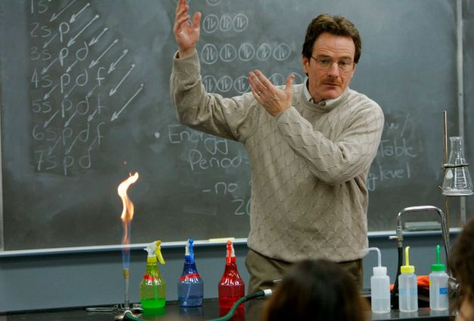
tl; dnr: be professional
Notes:
In general, most of your duties come down to...
- way you dress, present yourself. being on time, reliable.
- conduct yourself with your students
- interact with the rest of the course staff
- be reliable and professional

Slide 40
questions about duties?
Course communication and administration
Homework, exams, solution sets
Grading and grade tracking
Office hours, sections, reviews
Feedback and suggestions
SCPD Courses
Struggling students...
Notes:
are there any questions about what we just talked about?

Slide 41
thought experiment
It’s the night before the problem set is due. Your office hours are packed because poor wording on the assignment has made the question confusing. Angry comments are starting to pile up on Piazza. It’s chaos. The prof is out of town and unreachable. What do you do?
Notes:
It’s the night before the problem set is due. Your office hours are packed because poor wording on the assignment has made the question super confusing.
Chaos, angry, ... passive aggressive/aggressive-aggressive comments are starting to pile up on Piazza. The prof giving a talk out of town. What do you do?

Slide 42
university policies
https://oae.stanford.edu/video-resource-teaching-assistants
Notes:
* maybe put this at the beginning of the training
This is for your benefit! Watch on your own. (20 min)

Slide 43
agenda
University policies
Your duties as a Course Assistant
Effective teaching
Additional resources
Your questions

Slide 44
effective teaching
Teaching Awards
Centennial Teaching Assistant Award (Stanford)
Forsythe Memorial Teaching Award (Computer Science)
Ph.D. with distinction in teaching
10 units (“250%”) CAship or Teaching Fellow
At least one course as Teaching Fellow where you have primary responsibility of organization and teaching

Slide 45
what makes a great CA?
Notes:
wrap up by asking you…

Slide 46
what makes a great CA?
Preparation and organization
Knowledge of the course material
Communication skills
Accessibility and availability
Concern for students’ learning
A good relationship with the professor

Slide 47
effective teaching
Movie time!

Slide 49
Thoughts?

Slide 51
Thoughts?

Slide 53
Thoughts?

Slide 55
Thoughts?

Slide 57
Thoughts?

Slide 58
agenda
University policies
Your duties as a Course Assistant
Effective teaching
Additional resources
Your questions

Slide 59
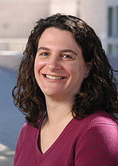
CS Department
CS Educational Affairs
Meredith Hutchin (hutchin@cs)
Notes:
you already know meredith...

Slide 60
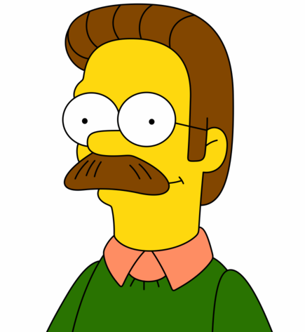
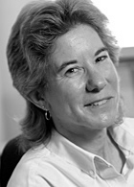
CS Department
Steven Magness (magness@cs, Gates 187)
Copy codes for course materials
Classroom reservations
Equipment loans:
Projector, computer, TV, DVD, etc.
Provide 2 days notice
Claire Stager (stager@cs, Gates 182)
CA textbook library (quarterly loans)
Food and drinks for midterm/final exam grading

Slide 61
CS Department
Computer Science CA Mentors
Teaching/organizational help, anything else!
David Hyde
(dabh@stanford.edu)
Jason Riggs
(jnriggs@stanford.edu)

Slide 62
Formerly the CTL - Center for Teaching & Learning
Provides resources to promote excellence in teaching and student learning
Classroom evaluations and videotaping
Focused training sessions
Teaching tips and handouts
Lunchtime lectures and workshops
http://teachingcommons.stanford.edu

Slide 64
online - sutacs
Repository of useful CA information:
http://sutacs.stanford.edu
New CA information (including these slides)
Course Assistant information sheet
Mass grading tips
Links to policies and guidelines
For quick tips, see:
http://cs.stanford.edu/academics/course-assistants-cas/current-cas

Slide 65
questions about resources?
Computer Science Department
VPTL (formerly CTL)
SUTACS

Slide 66
agenda
University policies
Your duties as a Course Assistant
Effective teaching
Additional resources
Your questions

Slide 67
What did we miss?

Slide 68
what makes a great CA?
Passive Assistant
Less work
Active Partner
Much more enjoyable and rewarding
Establish good relationships
Students prefer CAs that care
Doesn‘t necessarily imply a major time sink
Be an active partner and enjoy your time CA’ing!
Notes:
What I want you to take away from this is that ...

Slide 69
lots more support...
Use your resources!
VPTL (workshops & teaching feedback)
Mentors in Teaching - MinT - Program
Professors & other CAs
Further mentoring...
Coffee/tea, one-on-one meetings, groups, ...
Ideas?
Notes:
I would always love help with MinT / CA training!

Slide 70
Homework:
Get prepared - talk to your prof & fellow CAs, course website, schedule staff meetings, ...
Check out CS TAs website:
http://sutacs.stanford.edu
http://cs.stanford.edu/academics/course-assistants-cas/current-cas
Check out the VPTL resources website:
https://teachingcommons.stanford.edu/
Have fun!

